Slide 1
Optimise Diagnosis of Depression based on Hypertension and Sleep Apnea Factors
Group 7
Priyanka Bhyregowda, Ann Maria John, Madhulika Dutta, Shruti Badrinarayanan

Slide 2
Motivation
“About 21 million adults in the U.S. (8.4%) have experienced a major depressive episode” - WHO
National Health and Nutrition Examination Survey (NHANES) Data was pooled from the 2005-2008 and 2015-2020 study cycles (5 phases)
Original data encompasses information about depression risk along with many health indicators in the form of questionnaire responses
Total of 28 .csv files containing information on participant demographics, depression, sleep disorder, and hypertension is considered for the study.

Slide 3
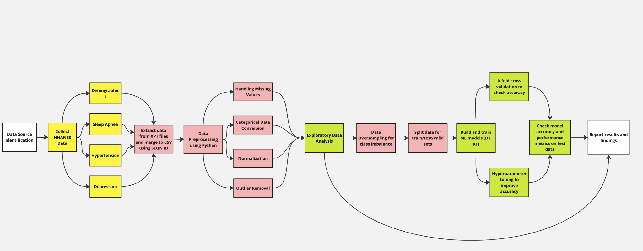
Project Overview

Slide 4
Preliminary Data Understanding
Depression Prevalent: Common depression symptoms like lack of interest and feeling down were reported by a significant portion of participants, though at lower intensity levels.
Sleep Issues: Sleep disturbances (trouble sleeping or sleeping too much) appeared relatively common among respondents.
Hypertension Concerns: Many respondents take medication for high blood pressure, indicating its prevalence within the dataset.
Diverse Dataset: Participants with various backgrounds.
Sleep Apnea and Hypertension: Majority reported not having sleep apnea (21,754 out of 24,108), and a majority are taking medication for high blood pressure (23,163 out of 24,108), which suggested a potential area of interest in exploring the relationship between hypertension and sleep apnea.
Lifestyle Factors: Most not current drinkers or smokers, which provides an interesting perspective on lifestyle factors that could be associated with depression, sleep apnea, and hypertension.

Slide 5
Data Pre-processing

Slide 6
Hidden Feature Extraction
Feature ‘Sleep Apnea’
Extracted from ‘how often do you snore’ and ‘how often do you snort/stop breathing’
Feature ‘Total Score’
Extracted from PHQ-9 which has 4 point Likert scale
Feature ‘Depression Category’
Extracted from ‘Total Score’ : >= 10 - severe; >=5 - mild; no
Extracted from ‘Thought you would be better off dead’

Slide 7
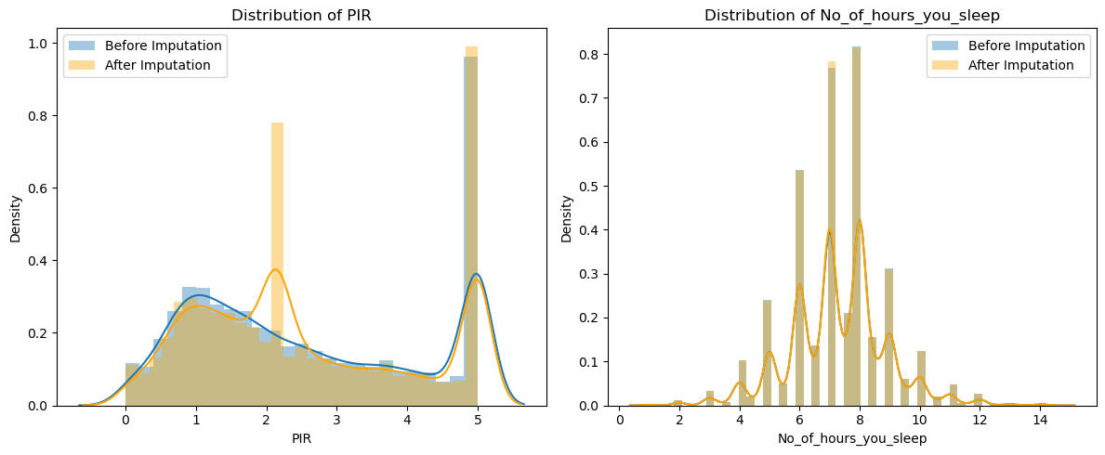
Insignificant columns were dropped
Missing value imputation
Numerical features - median

Slide 8
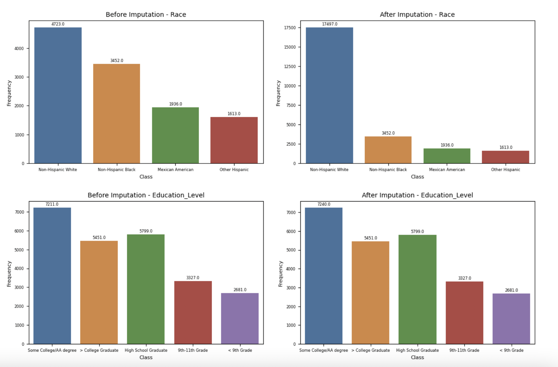
Missing value imputation
Categorical and discrete features - mode

Slide 9
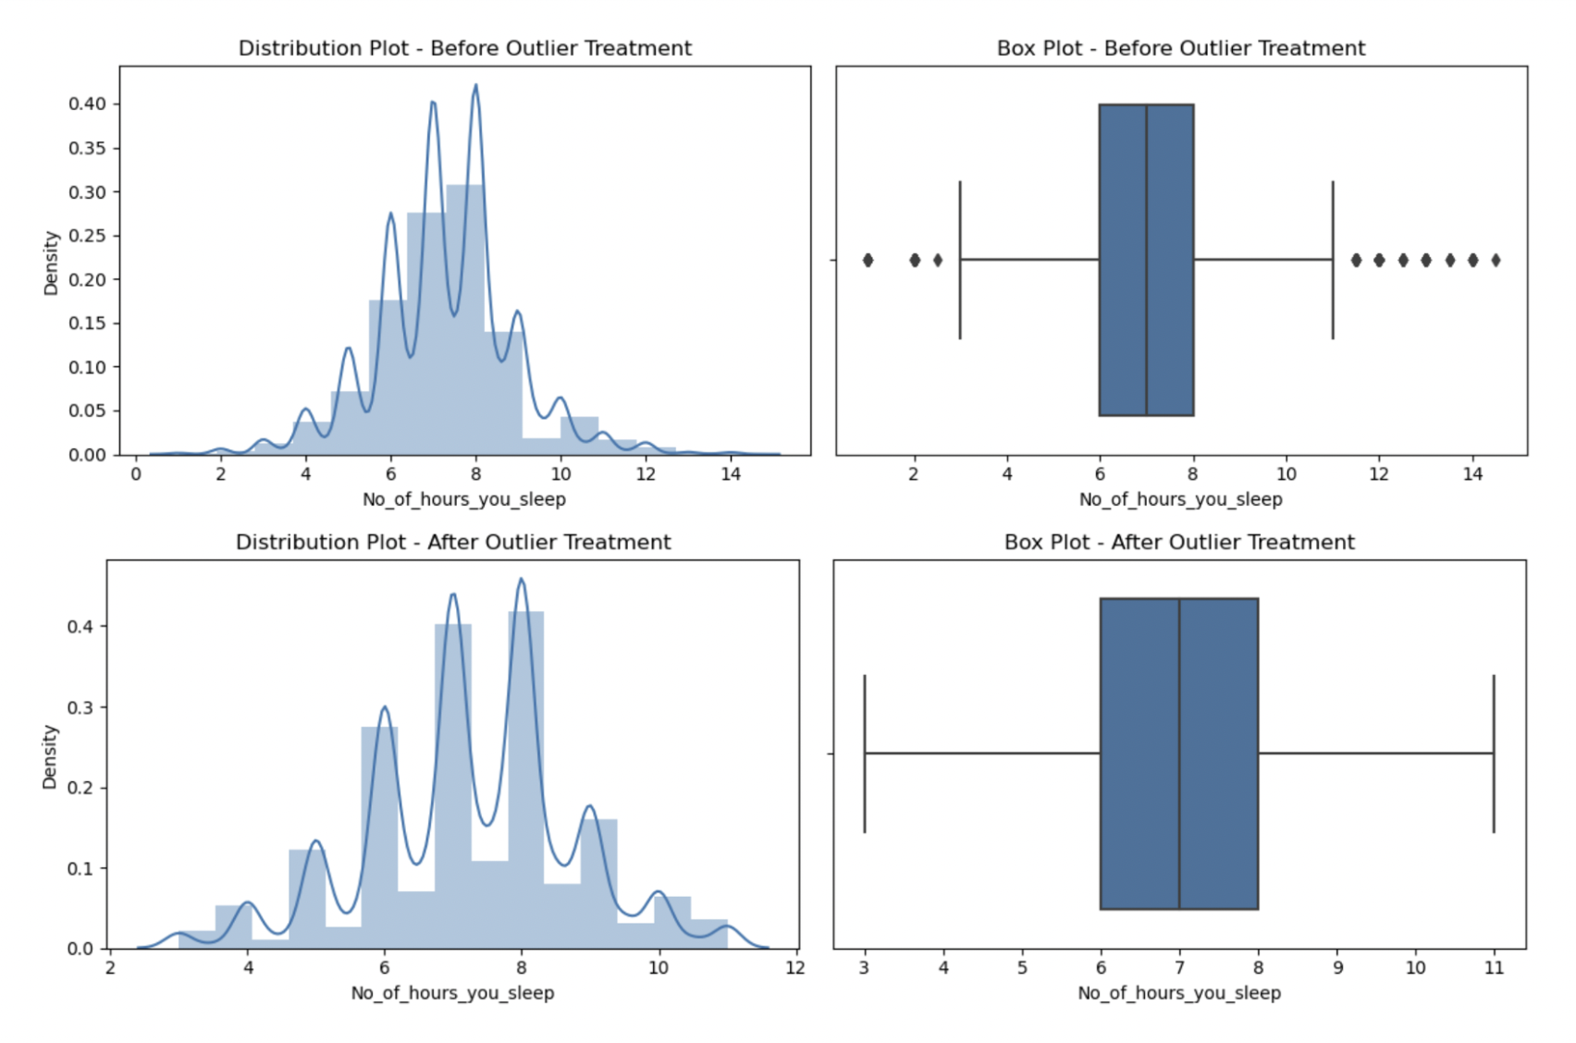
Outlier detection
IQR method

Slide 10
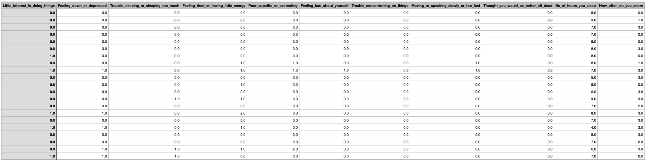
Feature encoding
Ordinal features - Label encoding
Nominal features - One-hot encoding
Sample data after feature encoding

Slide 11
Exploratory Data Analysis

Slide 12
Data Understanding
Prevalence of Symptoms
Respondents who reported experiencing symptoms of depression, such as ‘little interest in doing things’ and ‘feeling down or depressed’ had mean scores of 0.34 and 0.32, respectively.
Sleep-related issues, like trouble sleeping or sleeping too much, had a mean score of 0.57, indicating somewhat prevalent sleep disturbances among the respondents.
Demographic Characteristics
Gender: Balanced Representation
Race: Non Hispanic/White dominated
Marital Status: Married/Living with Partner - predominant
Education Category: High School Graduate

Slide 13
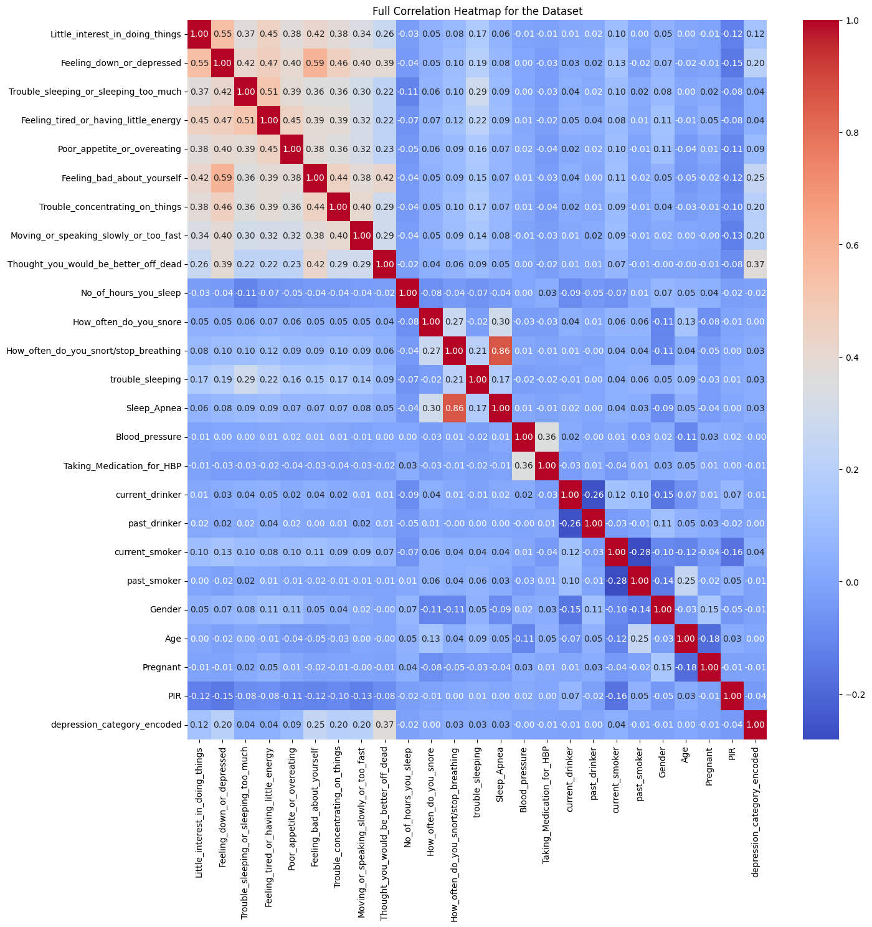
Correlation Heat Map

Slide 14
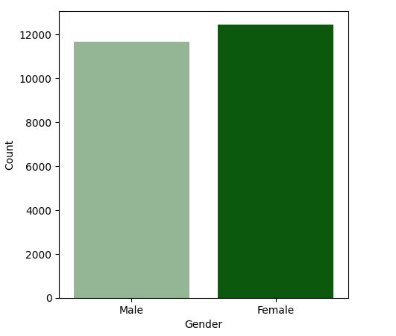
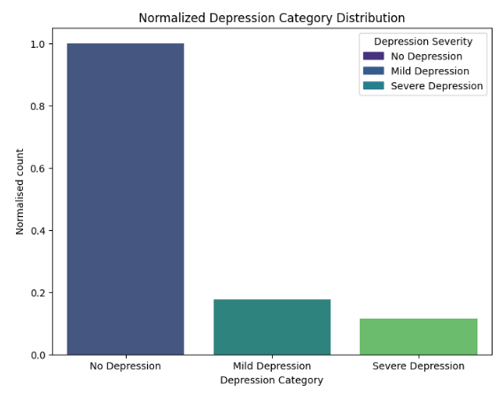
Gender Distribution
Depression Distribution
Balanced Data
Unbalanced Data

Slide 15
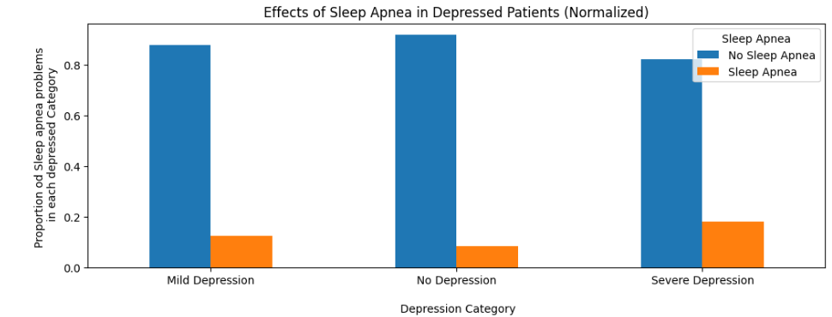
Effects of Sleep Apnea in Depression
Sleep Apnea is not related to Depression

Slide 16
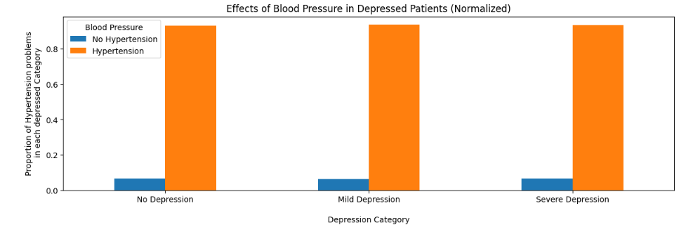
Effects of Hypertension in Depression
Hypertension may be common problem so, might not be related to Depression

Slide 17
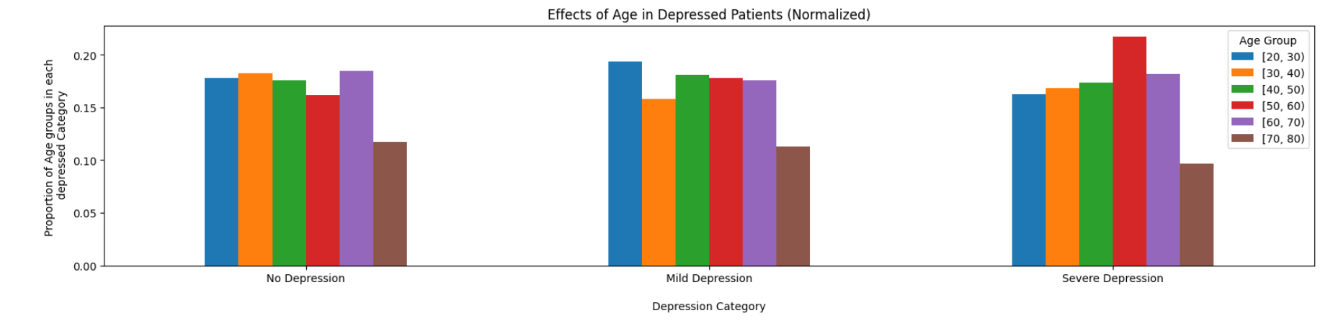
Age Vs Depression
People in the age of 50-60 undergo mild and severe depression

Slide 18
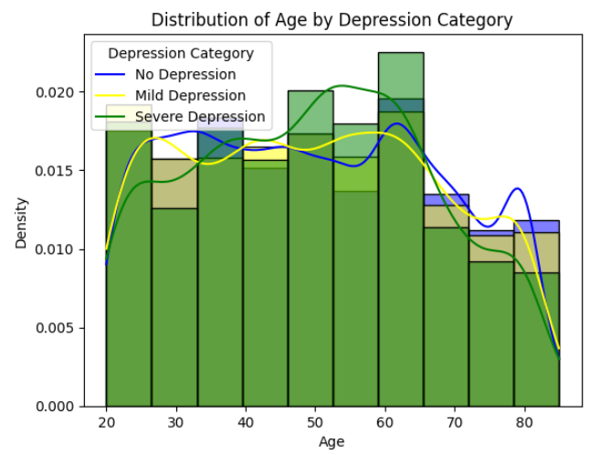
Age Vs Depression

Slide 19
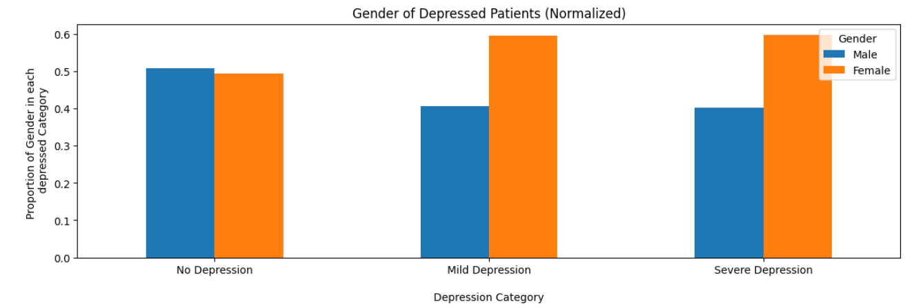
Role of Gender in Depression
Females are affected more than Males

Slide 20
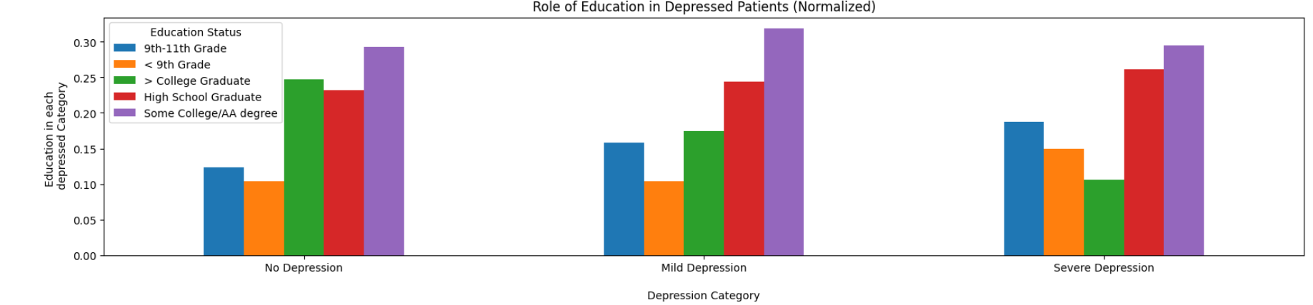
Role of Education in Depression
People with lower Education undergo more depression

Slide 21
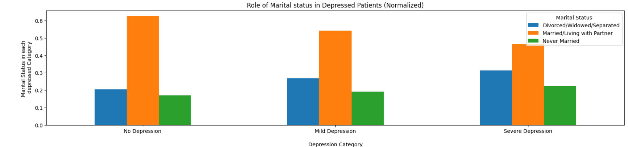
Role of Marital Status in Depression
People who are divorced/widowed/Separated and never married undergo more depression

Slide 22
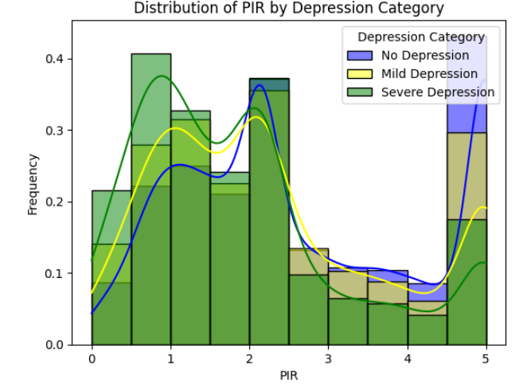
Depression and Income
People with lower PIR are more affected

Slide 23
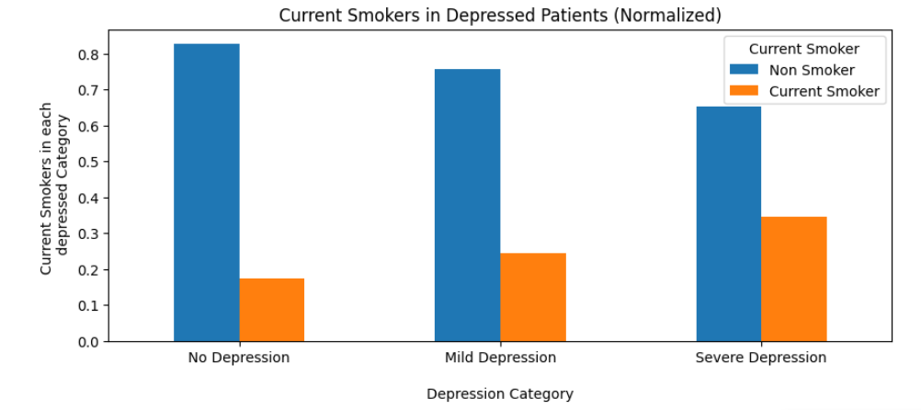
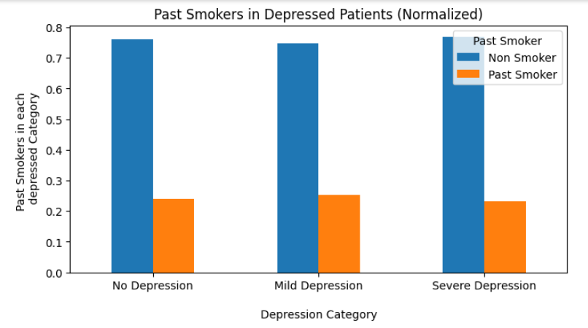
Depression and Smoker
People who are current smoker are more affected by depression

Slide 24
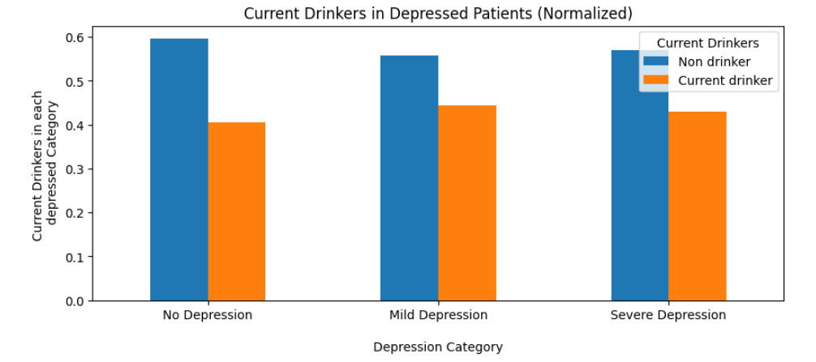
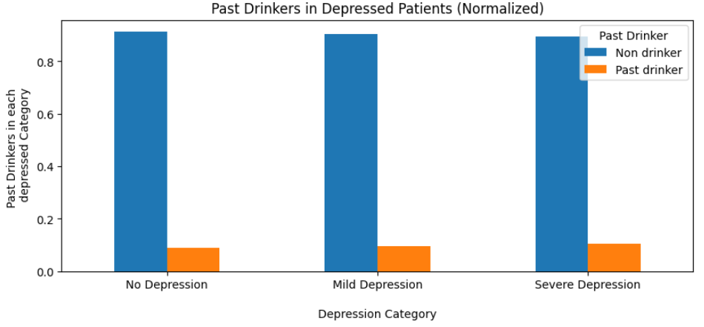
Depression and Alcoholism
People who are current drinkers are more affected by depression

Slide 25
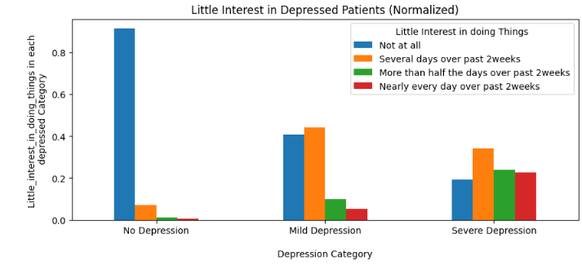
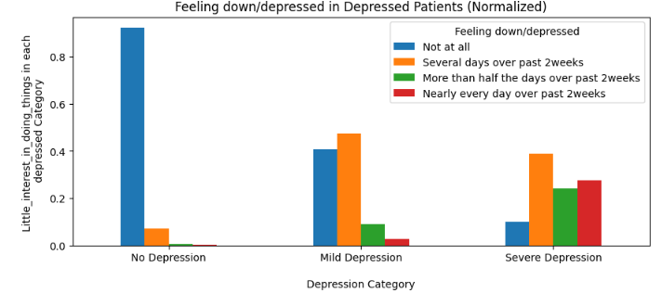
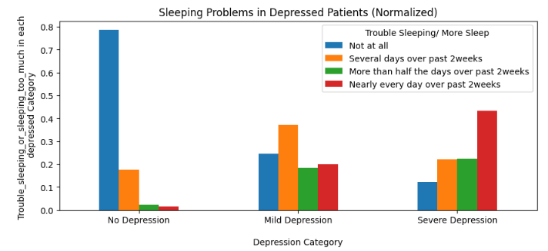
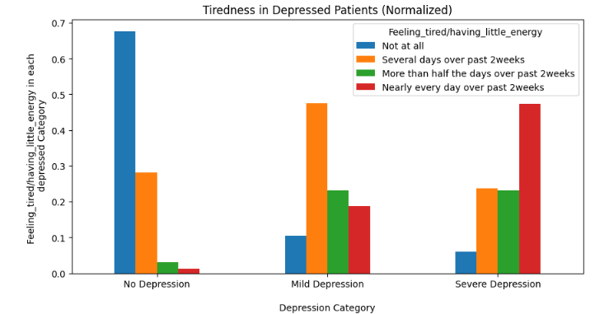
Major Symptoms in Depressed Patients

Slide 26
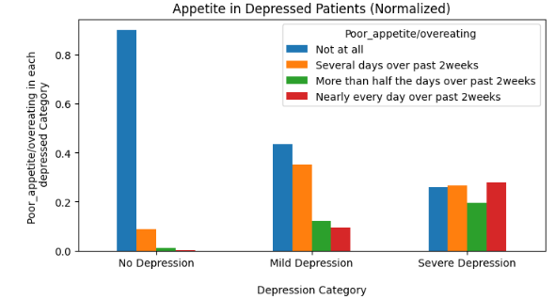
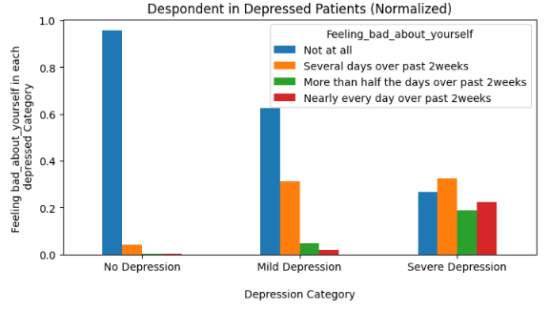
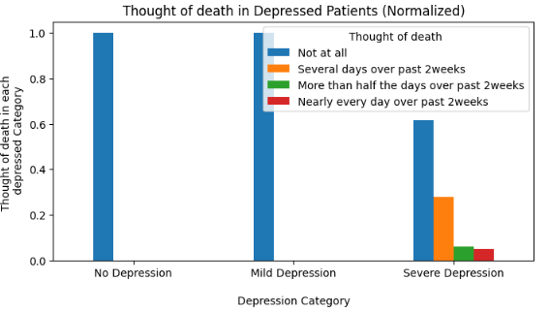
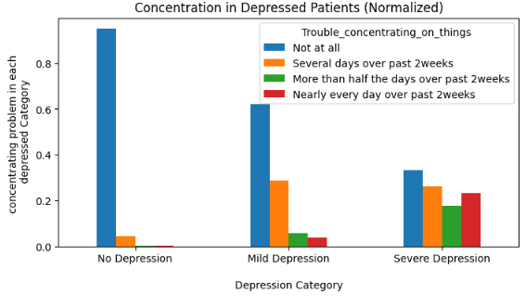
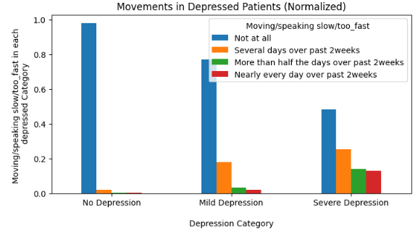
Major Symptoms in Depressed Patients

Slide 27
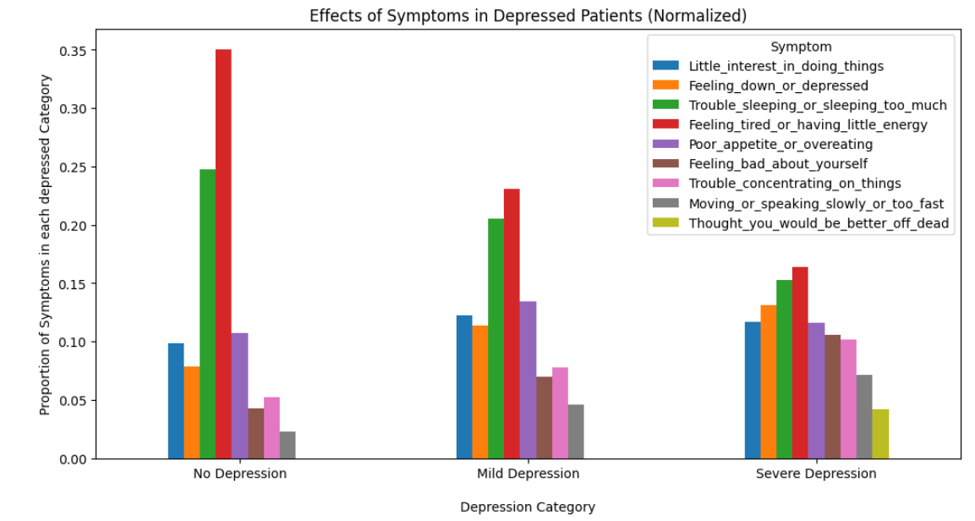
Symptoms Vs Depression
Common Symptoms: Feeling tired/little energy, Sleeping Issues.
Depression Problems: Thought of death, Little Interest in doing things, Feeling low, Poor appetite, Concentration problem, Moving/speaking slowly/too fast, Feeling bad about yourself

Slide 28
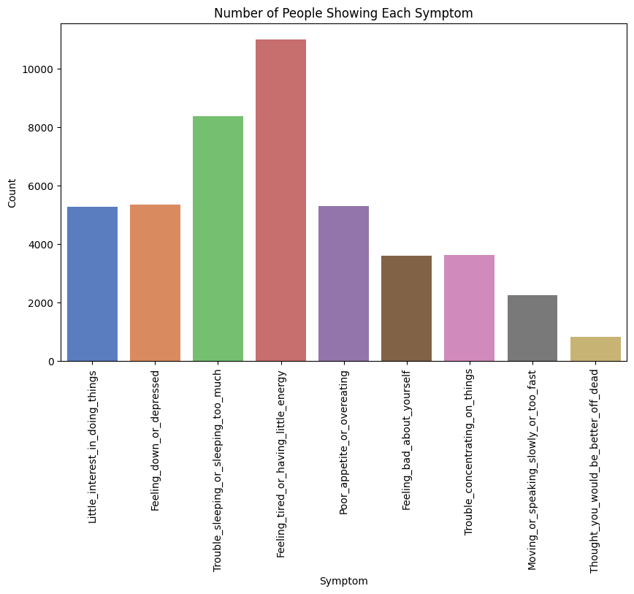
Count of each symptom in the population

Slide 29
Analysis Findings
Even though even distribution of Gender was considered the distribution of Marital status, Education level, Race was not balanced in the survey results.
Depression may not be significantly related into any health conditions.
Depression mainly deals the status of current stress levels, feelings of the patient. That is if the person thinks different from normal regular mood changes about everyday life for a longer time then he or she will will be stuck in depression.
Depression can be the cause for the sleep apnea, but not vice versa.

Slide 30
Modeling
and
Evaluation

Slide 31
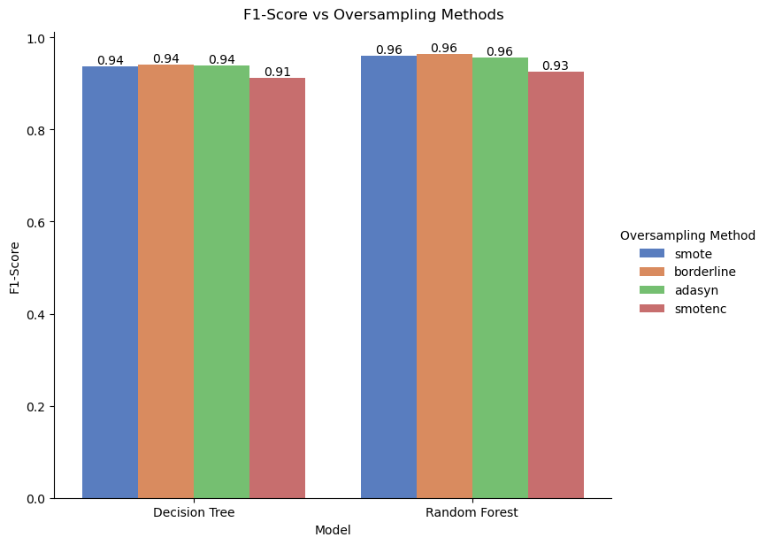
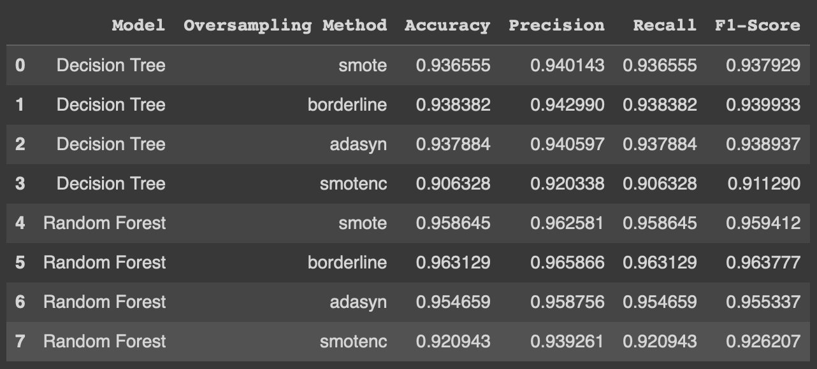
Choosing the best oversampling technique

Slide 32
Modeling steps
Data split into train, test and validation sets (60:20:20)
Baseline models built on the train set
Prediction and evaluation were done on the validation set
Hyperparameter tuning using grid search on train and validation sets
Obtained set of optimal hyperparameters
Stratified k-fold cross validation using optimal hyperparameters
Tested the models with optimal hyper-parameters on unseen data

Slide 33
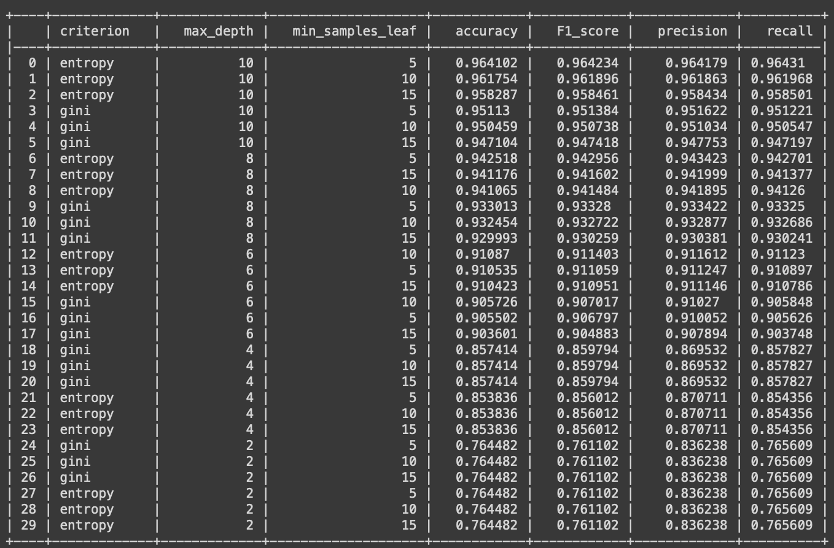
Decision Tree
Hyperparameters :
max_depth_array = [2,4,6,8,10]
min_s_leaf_array = [5,10,15]
criterions_array = ['gini','entropy']
Optimal hyperparameters :
max_depth = 10
min_sample_leaf = 5
criterion = entropy

Slide 34
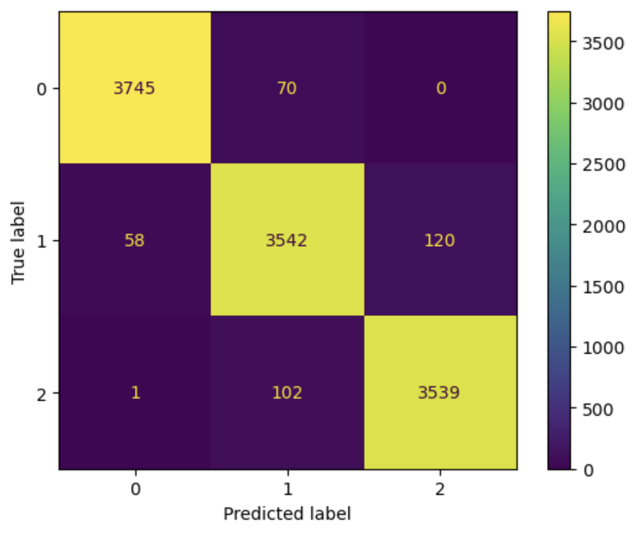
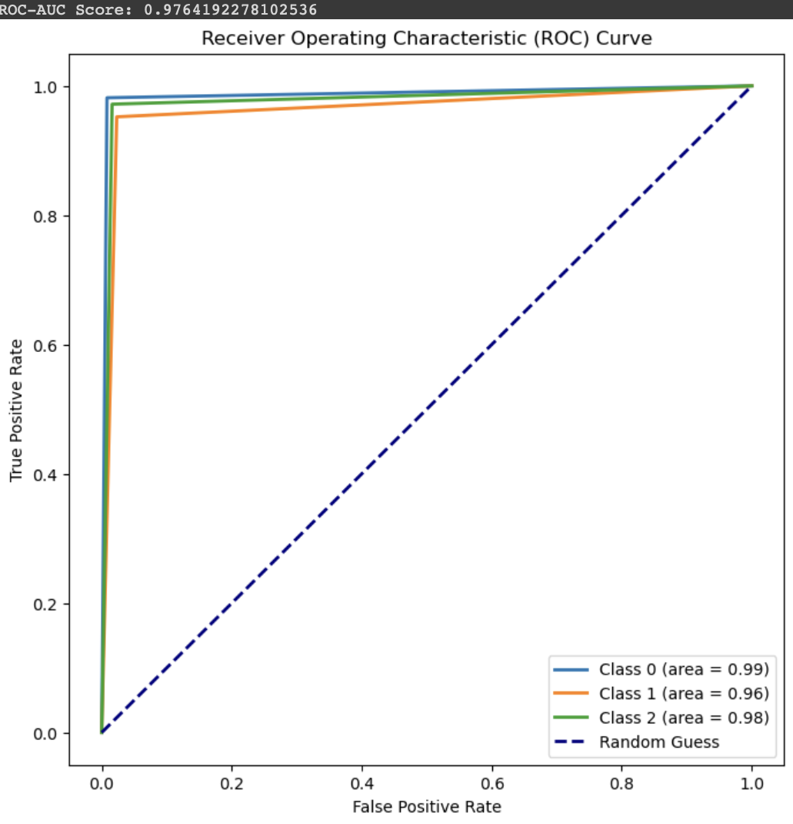
Decision Tree - Evaluation Metrics
Metric | Score
Accuracy | 0.9685
Precision | 0.9686
Recall | 0.9685
F1 score | 0.9685
ROC-AUC score | 0.9764
Confusion Matrix
ROC Curve

Slide 35
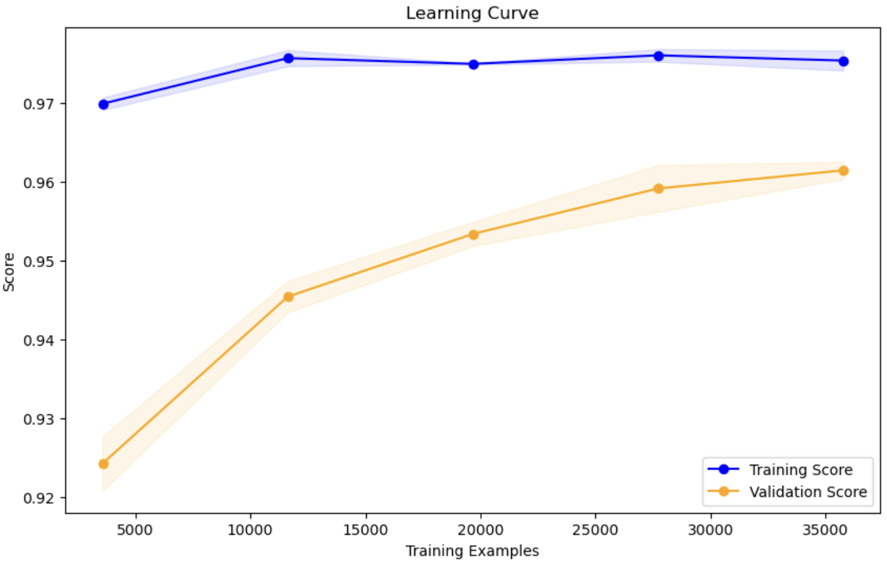
Decision Tree - Learning Curve
DT learning curve with accuracy score shows an almost steady training score and an increasing validation score

Slide 36
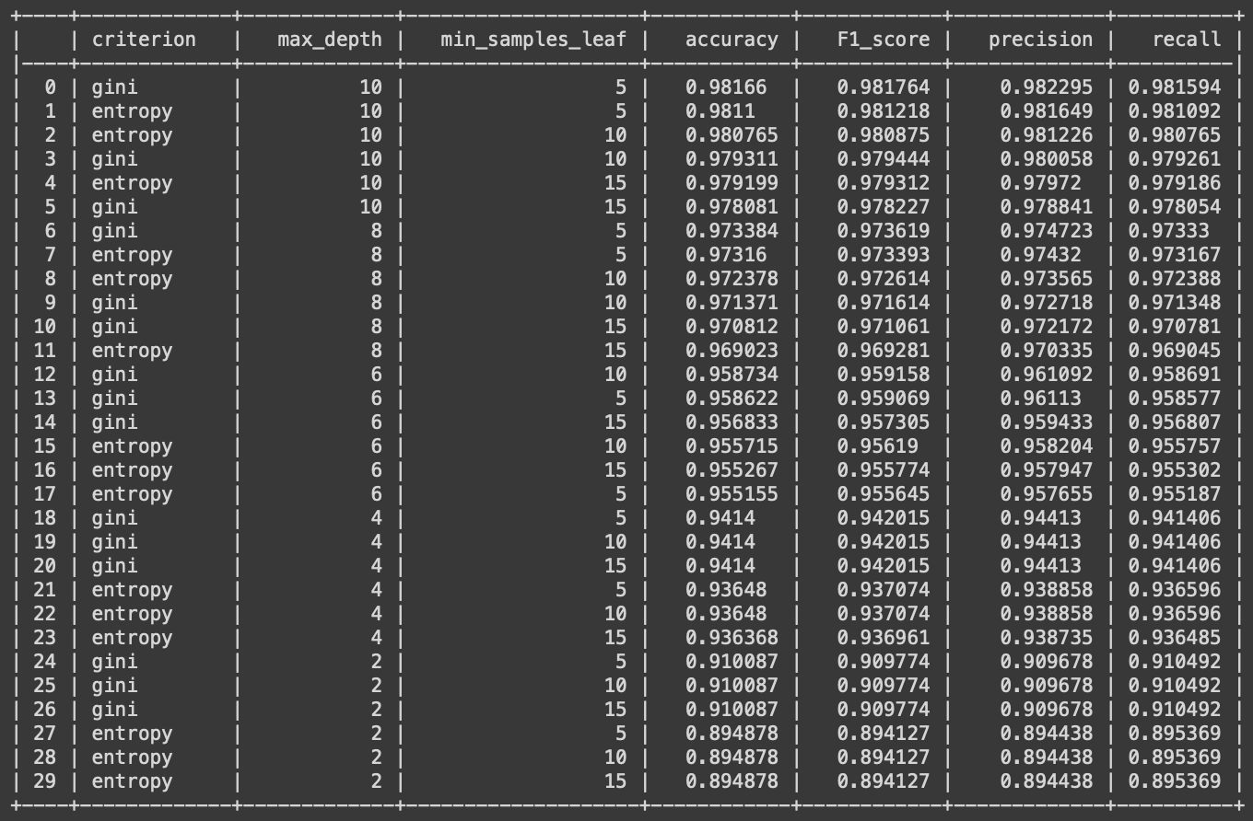
Random Forest
Hyperparameters :
max_depth_array = [2,4,6,8,10]
min_s_leaf_array = [5,10,15]
criterions_array = ['gini','entropy']
Optimal hyperparameters :
max_depth = 10
min_sample_leaf = 5
criterion = gini

Slide 37
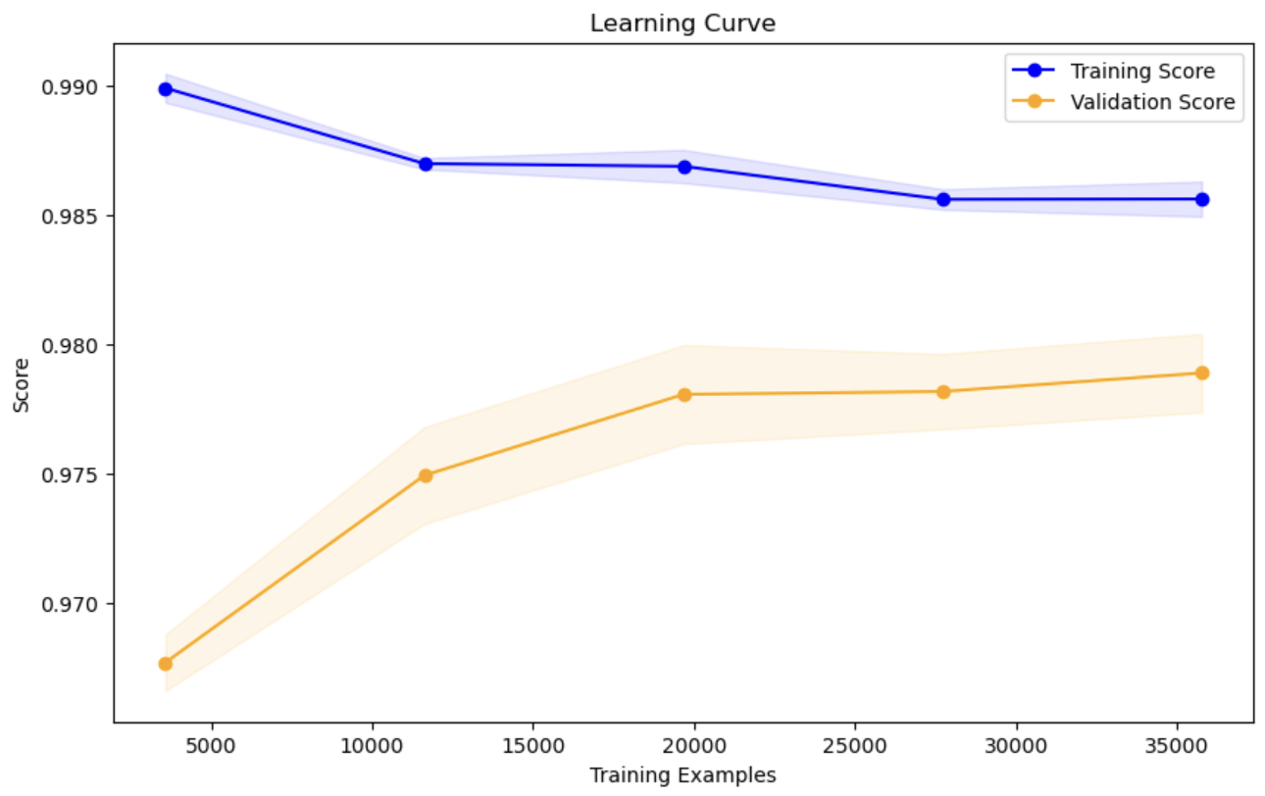
Random Forest - Learning Curve
RF learning curve with accuracy score shows a decreasing training score and an increasing validation score

Slide 38
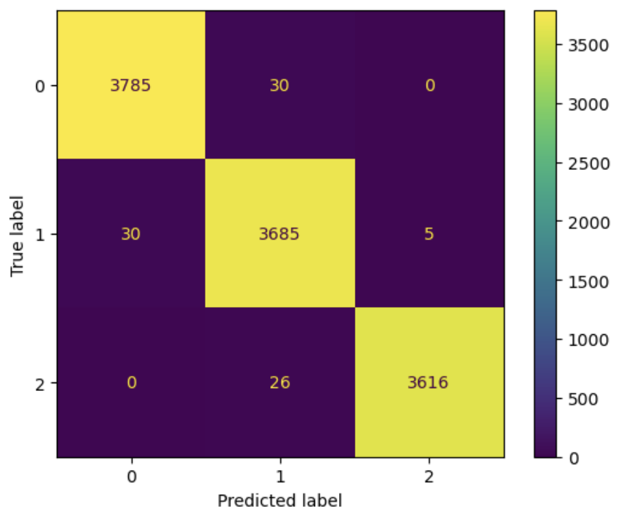
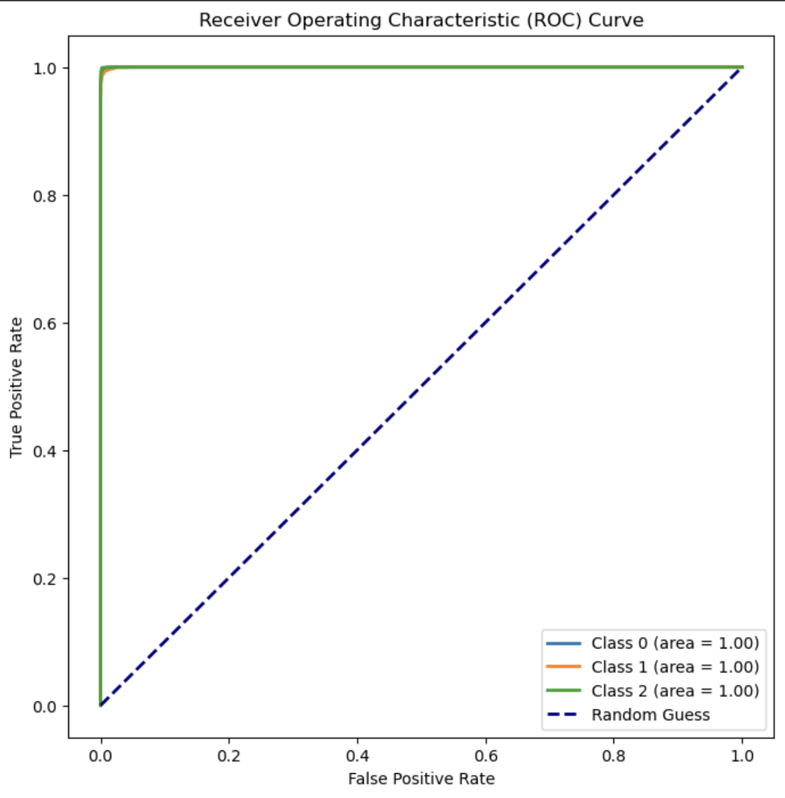
Random Forest - Evaluation Metrics
Metric | Score
Accuracy | 0.9918
Precision | 0.9918
Recall | 0.9918
F1 score | 0.9918
ROC-AUC score | 0.9999
Confusion Matrix
ROC Curve

Slide 39
Creativity in terms of Data Analysis / Modeling

Slide 40
Ablation Study
Feature Ablation
Remove features one by one to see their individual impact on the model’s performance.
Helps in determining the importance of individual features or model components, facilitating optimization and simplification.
Methodology
Model Used: Decision Tree Classifier (Baseline with all features established initially).
Procedure: Each feature was removed one at a time from the model, and the model's accuracy was compared to the baseline accuracy with all features included.

Slide 41
Ablation Study : Key Findings
High Impact Features
Removal of "Thought you would be better off dead", "No of hours you sleep", and "How often do you snort/stop breathing" significantly decreased model accuracy, indicating strong predictive power for depression.
Moderate Impact Features
Features like "Feeling bad about yourself" and various demographic indicators (e.g., race, marital status) showed moderate effects on accuracy.
Low Impact Features
Removing "Race_Non-Hispanic White" showed minimal change in accuracy, suggesting lower relevance to the model's predictive capability for depression.

Slide 42
Ablation Study : Recommendations for Future Work
Prioritize Key Features: Focus on incorporating and potentially engineering features related to critical predictive factors like sleep disturbances and severe depressive symptoms.
Feature Reduction: Consider reducing less impactful features to simplify the model, potentially improving performance and reducing overfitting.
Further Research: Explore deeper interactions or nonlinear effects among moderate and low-impact features to uncover hidden insights.
Iterative Modeling: Refine the model by adjusting feature sets based on ablation insights and re-evaluate performance.
Expand Feature Set: Investigate adding more new features that might capture other aspects of depression not currently represented.

Slide 43
Community Contribution

Slide 44
Exploring Complex Relationships Between Depression and Health Conditions
Presence of comorbid depression can significantly impact the management and outcomes of physical health conditions, and vice versa. Based on this, healthcare providers can adopt integrated care approaches to address both mental and physical health needs concurrently and optimize resource allocation.
Understanding Depression Beyond Physical Health Indicators
Findings indicate that depression primarily manifests through changes in stress levels and persistent negative feelings, rather than being directly linked to specific physiological markers. This knowledge can be used to refine diagnostic criteria and interventions.
Recognizing Depression as a Potential Contributor to Sleep Apnea
Further studies on understanding how depression affects sleep will help develop interventions for improving patients’ sleep quality and overall health.
Developing Inclusive Mental Health Initiatives
There are imbalances in demographic representation, particularly in marital status, education level, and race, within the survey results. Recognizing this, targeted outreach programs aimed at marginalized communities can help provide them the required mental health resources.

Slide 45
Potential Application
Data exchange between the ML application and the healthcare system EHR platform allows healthcare providers to access user's mental health assessment results directly
Login/
Registration Portal
Users create an account and log in to portal
Electronic Health Record (EHR) Integration
Clinical decision support to provide real-time insights and recommendations to healthcare practitioners
Answer series of questions related to mental well-being, including existing survey questions and additional ones for comprehensive analysis
Survey Interface
Telemedicine Integration
Facilitate virtual consultations by matching users and healthcare providers. Enable remote assessments and e-prescribing
Population Health Management
Dashboard
Perform population health analytics to identify trends and outcomes across demographics
Displays the user's mental health assessment results, providing insights and recommendations based on machine learning analysis
Referrals and Care Coordination
Generate personalized care plans outlining recommended interventions and follow-up actions

Slide 46
References
https://wwwn.cdc.gov/nchs/nhanes/continuousnhanes/default.aspx?Cycle=2017-2020
https://www.frontiersin.org/articles/10.3389/fpubh.2023.1348803/full
https://journals.plos.org/plosone/article?id=10.1371/journal.pone.0272330
https://link.springer.com/content/pdf/10.1186/s12888-023-05109-9.pd

Slide 47
Thank You

